Slide 1


Know Yourself
Using AI

Slide 2
Team Members
2110030020-Ch. Sri Chandana
2110030028-Praneeth
2110030085-N. Manas
2110030359-B.Chihnita Reddy

Slide 3

Problem Statement
Limited access to medical professionals hinders early disease detection due to cost and time constraints. This necessitates a user-friendly tool for symptom-based health insights.

Slide 4
Introduction
Limited healthcare access creates delays in diagnosing illnesses.
This project proposes a user-friendly web application powered by machine learning (ML).
Users input symptoms and receive insights into potential diseases and self-care options.
This empowers individuals to manage their health and potentially avoid unnecessary doctor visits.
The AI-powered approach aims for faster, more accessible, and cost-effective early disease detection.

Slide 5
Why This?
Despite advancements in healthcare, many individuals lack immediate access to medical professionals for early disease detection.
This can lead to delayed diagnosis, potentially worsening health outcomes and increasing healthcare costs.
The high cost of healthcare, including doctor visits, diagnostics, and medications, can prevent individuals from seeking medical attention, particularly for minor or undiagnosed symptoms.
Busy work schedules or long appointment wait times can make it difficult for individuals to prioritize preventative healthcare or seek medical attention for early symptoms.
The existing solutions are not cost-effective as they require spending money on doctor visits even for minor health issues.

Slide 6
Project Objective
An individual's lifestyle plays the most crucial role in determining their risk of cardiovascular diseases.
Early Detection:
Inform users about potential illnesses and emphasize the importance of early medical attention. Reduce unnecessary doctor visits for minor ailments by relevant health resources based on the predicted disease.
User-friendly:
User-friendly interface, easy to understand & multi-device support.
Cost Effective:
Minimize healthcare costs by offering a web-based tool for early disease detection and self-care guidance, reducing unnecessary doctor visits.
Optimizing Medical Care:
Reduce unnecessary doctor visits for minor ailments by relevant health resources based on the predicted disease.

Slide 7
Features of Project
An individual's lifestyle plays the most crucial role in determining their risk of cardiovascular diseases.
The user-friendly web application empowers individuals with early disease insights and self-care guidance.
This web application helps you skip long wait times and crowded waiting rooms for minor health concerns.
SymptoSage empowers early detection of both minor and potentially dangerous diseases, fostering preventive care.
This web app cuts healthcare costs by enabling early disease detection, self-care for minor issues, and reducing unnecessary doctor visits.
This AI-powered web app surpasses existing solutions by offering more accurate disease predictions and self-care guidance, reducing healthcare costs.

Slide 8
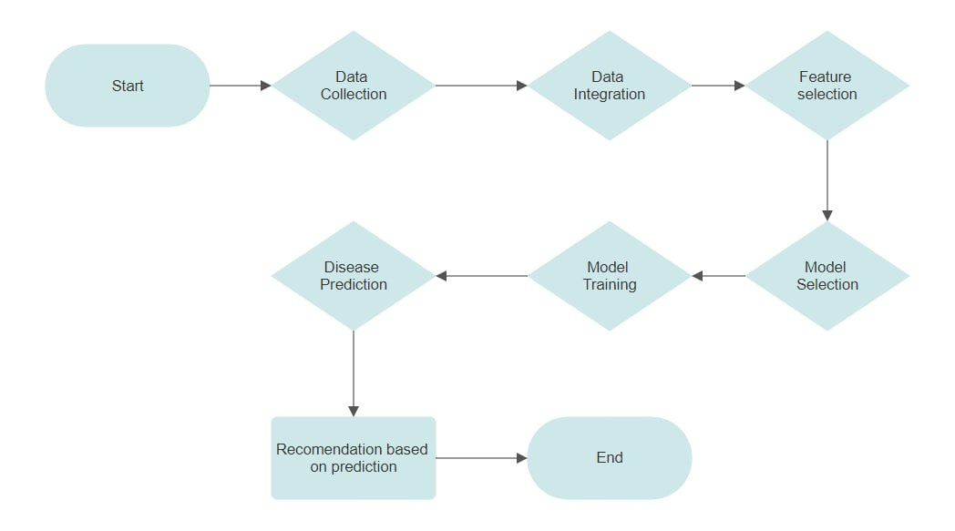
Process Flow
An individual's lifestyle plays the most crucial role in determining their risk of cardiovascular diseases.

Slide 9




Technology Stack
An individual's lifestyle plays the most crucial role in determining their risk of cardiovascular diseases.
The technology stack used for this project is:
Frontend:
HTML5
CSS3
Bootstrap
Backend:
Python
Flask
Machine Learning

Slide 10
Thank You!

